Slide 1


THE TABLEAU HR SCORECARD: MEASURING SUCCESS IN TALENT MANAGEMENT

Slide 2
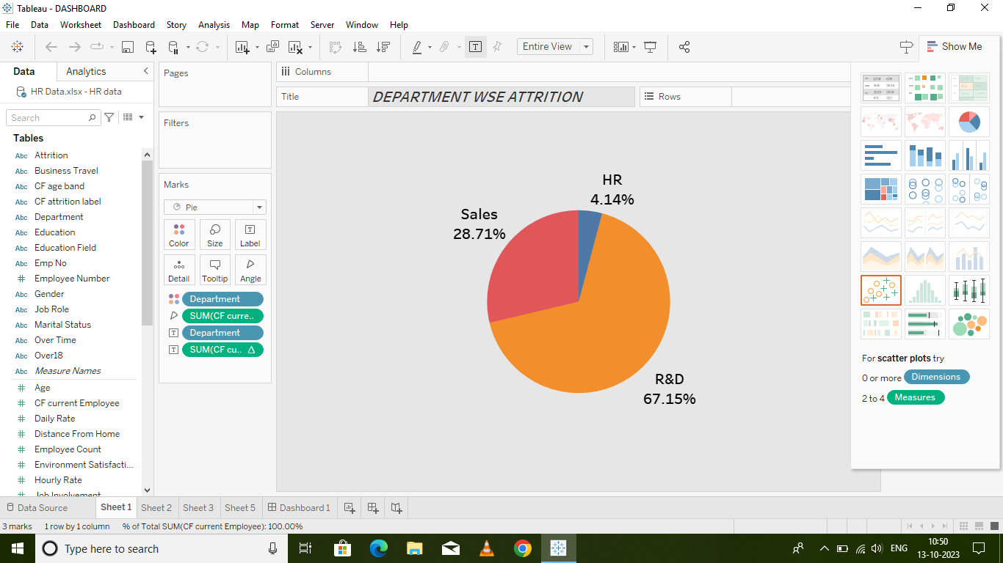

DEPARTMENT WISE ATTRITION

Slide 3
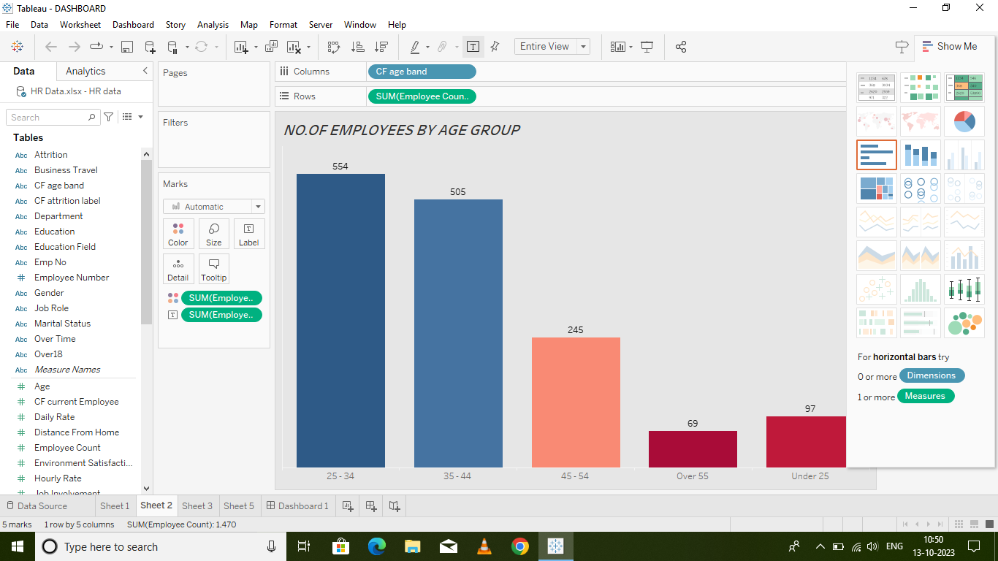
NO.OF.EMPLOYEES BY AGE GROUP

Slide 4
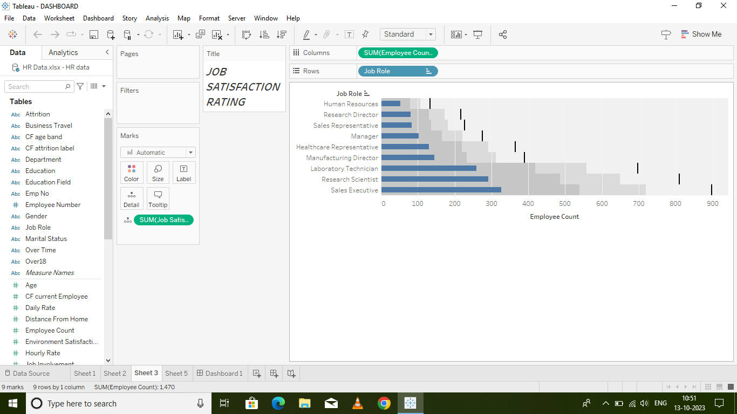
JOB SATISFACTION RATNG

Slide 5
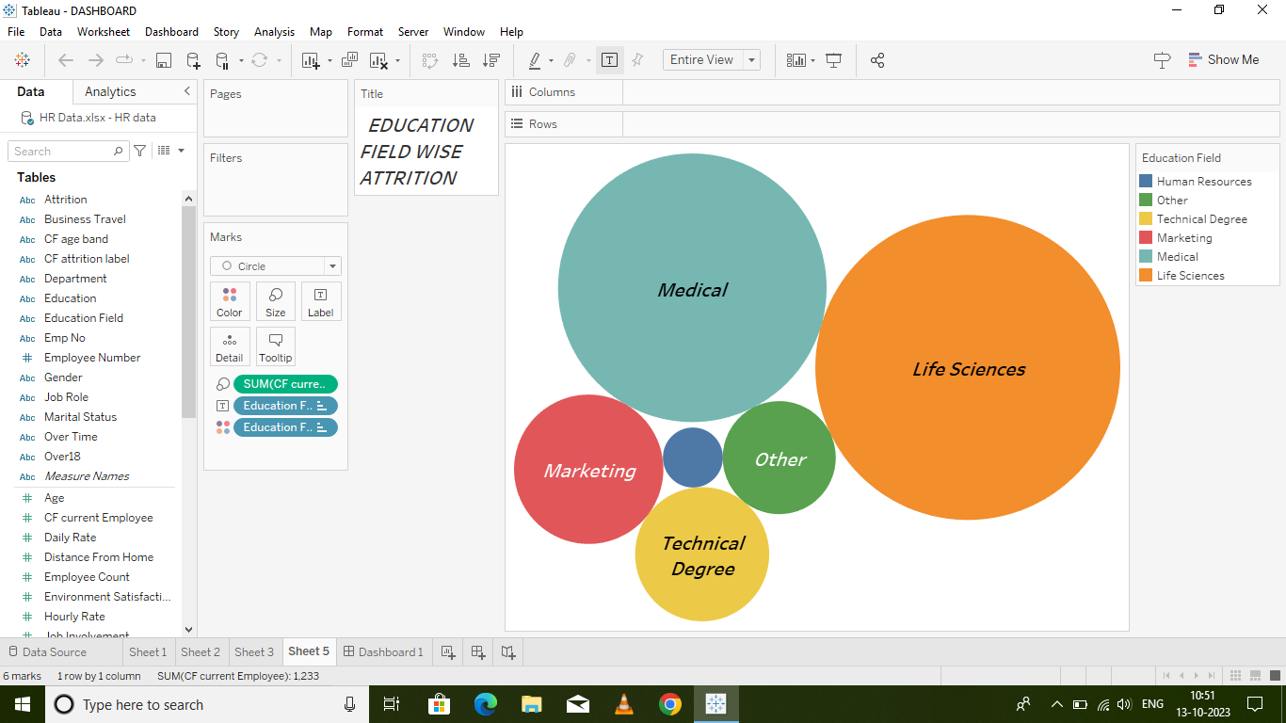
EDUCATION FIELD WISE ATTRITION

Slide 6
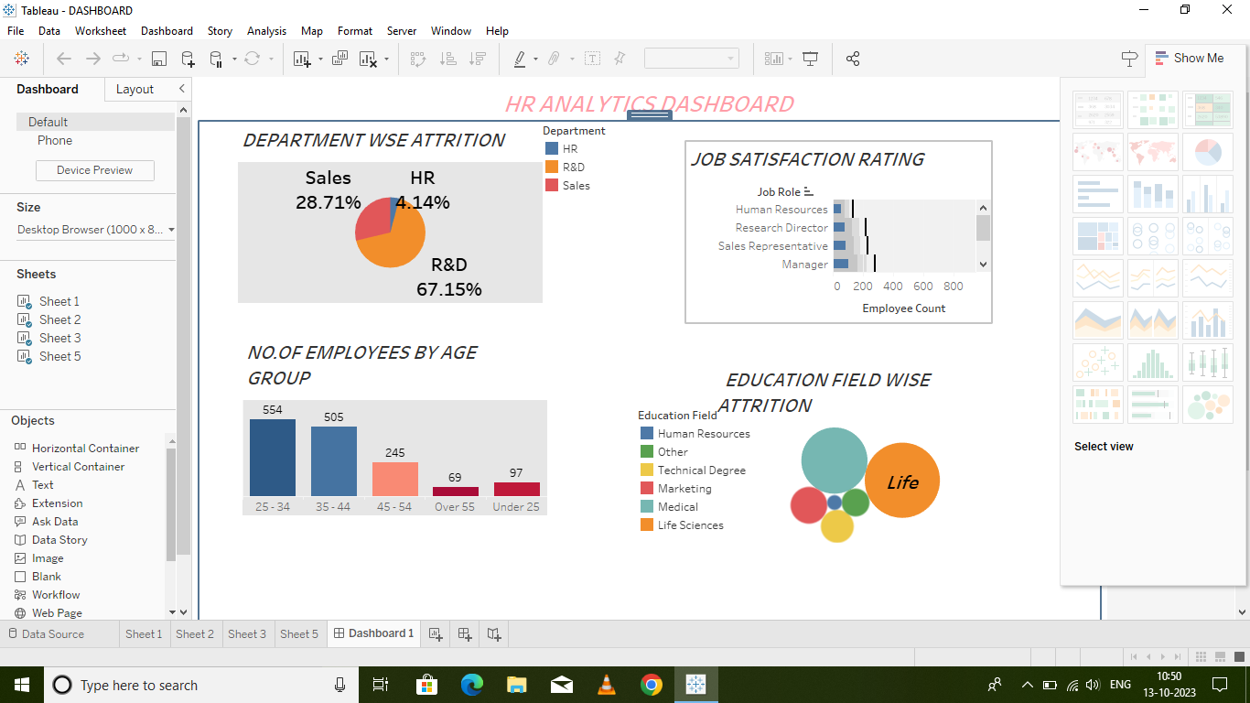
DASHBOARD

Slide 7
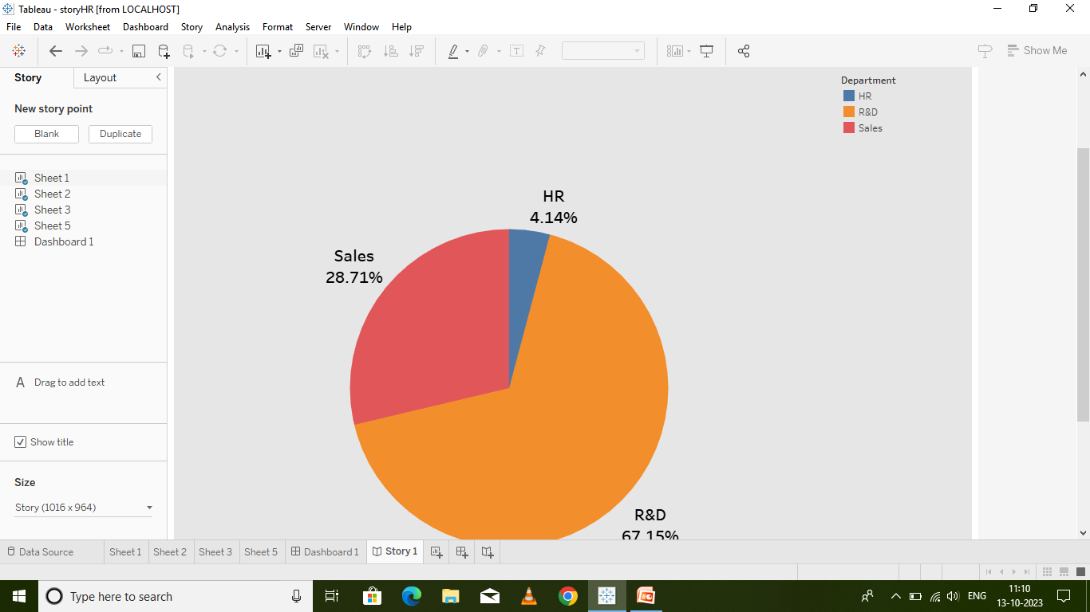
STORY

Slide 8
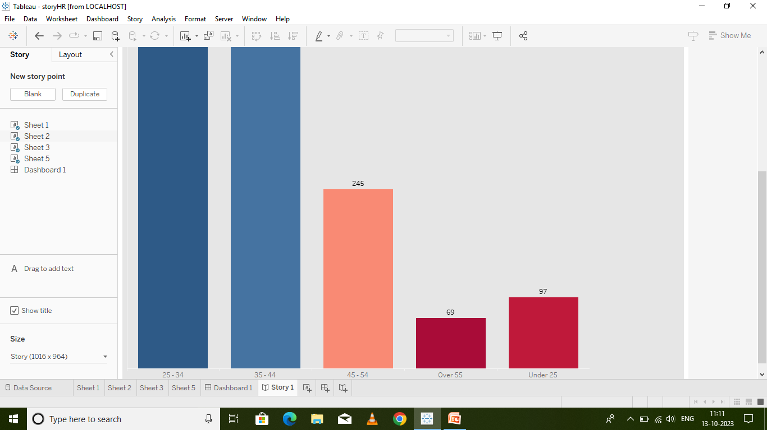
STORY

Slide 9
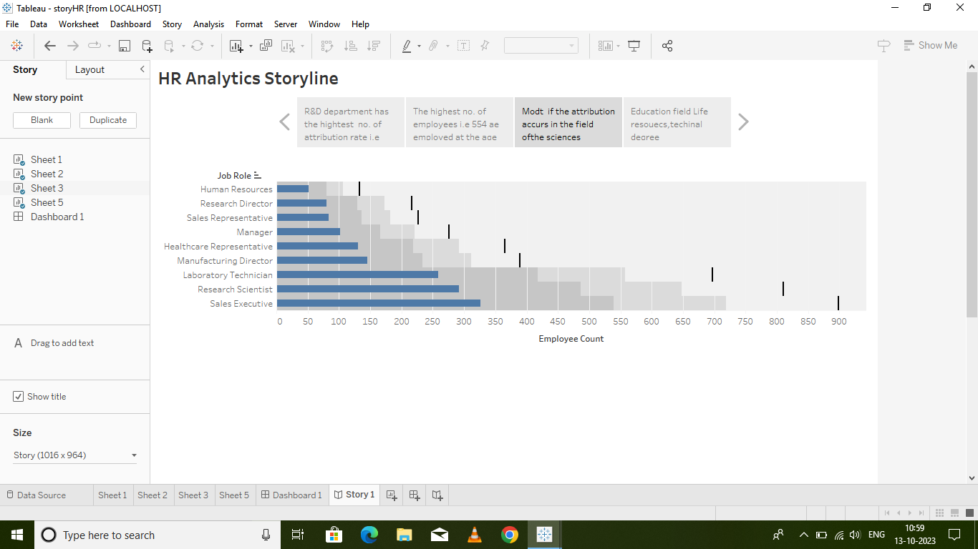
STORY

Slide 10
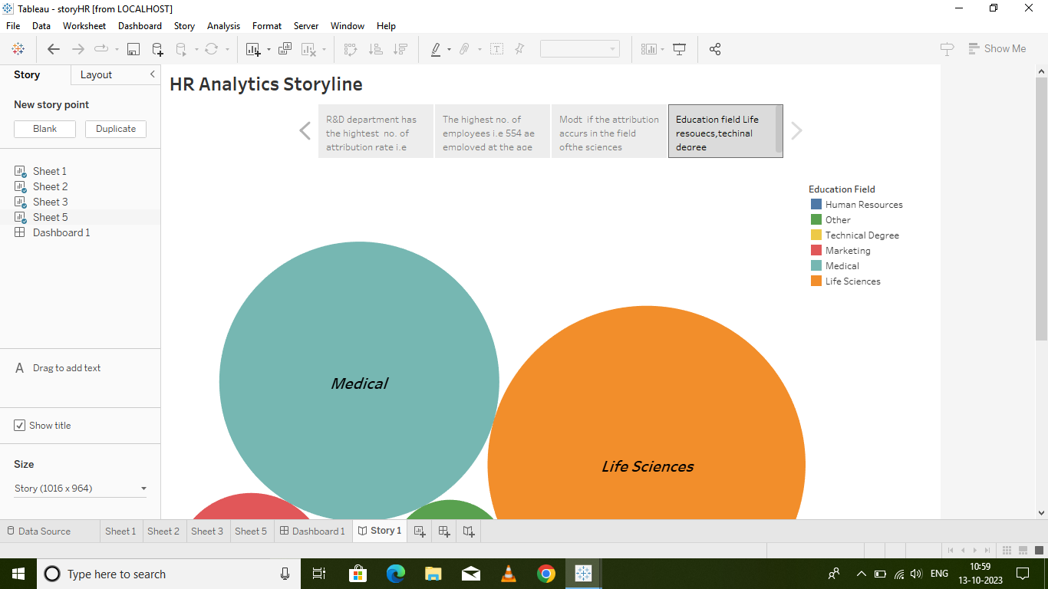
STORY

Slide 11
THIS PROJECT IS DONE BY
G.RAJESHWARI
U.GOPIKA
E.PRIYADHARSHINI
S.NISHA

